Slide 1
Human Induced Earthquakes: Causes and Effects
Team Members:
Meenakshi Nadimuthu
Sadhana Kulkarni
Himani Singh

Slide 2
Motivation to choose this topic?
Californians are no strangers to Earthquakes
Advanced technologies and seismic instruments record more earthquakes in the recent years.
We wanted to investigate the Human Induced earthquake causes and its influence on global earthquake data.

Slide 3
Tools
Jupyter Notebook
Pandas
USGS API
Matplotlib
Gmaps
Seaborn

Slide 4
Data Sources
Significant_Earthquakes - CSV file containing all natural earthquakes that occured between 1908 to 2015.
https://www.ngdc.noaa.gov/nndc/struts/form?t=101650&s=1&d=1
The_Human_Induced_Earthquake_Database - HiQuake - CSV file contained human induced earthquakes that occured between 1908 to 2018
http://inducedearthquakes.org/
Earthquake occurred in past day
https://earthquake.usgs.gov/earthquakes/feed/v1.0/summary/all_day.geojson

Slide 5
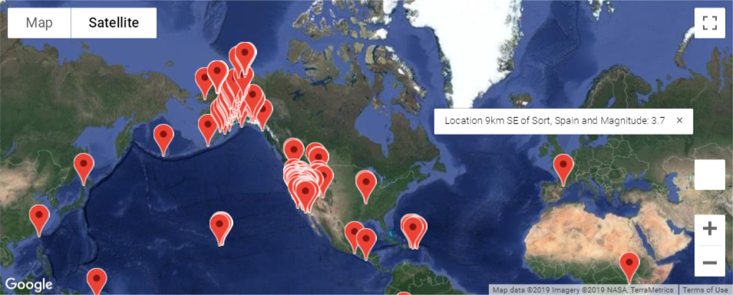
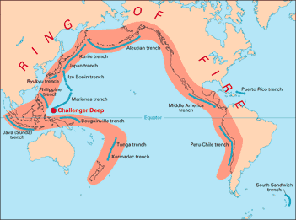
Visualization of Earthquakes occurred in the past day
Earthquakes occurred in the past day
gmap (marker_layer)

Slide 6
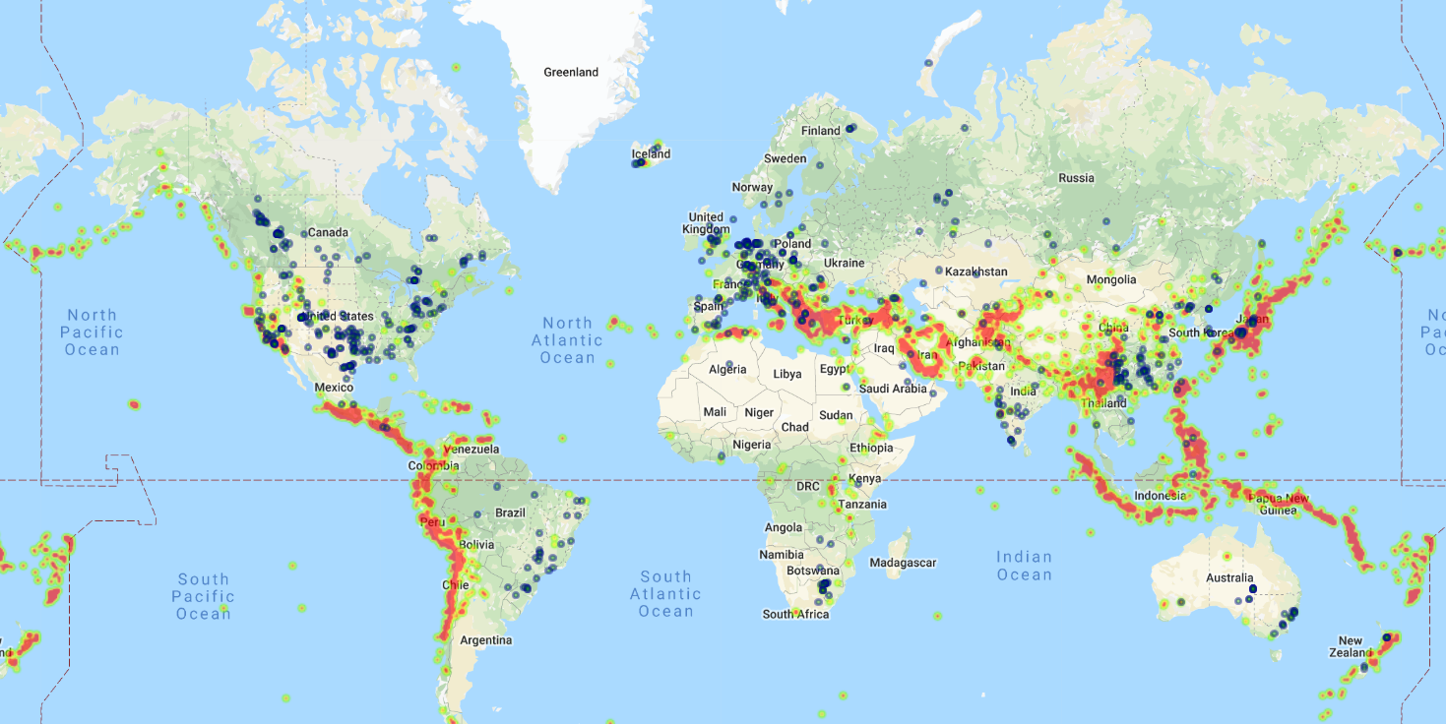
Natural and human induced earthquakes - across globe

Slide 7
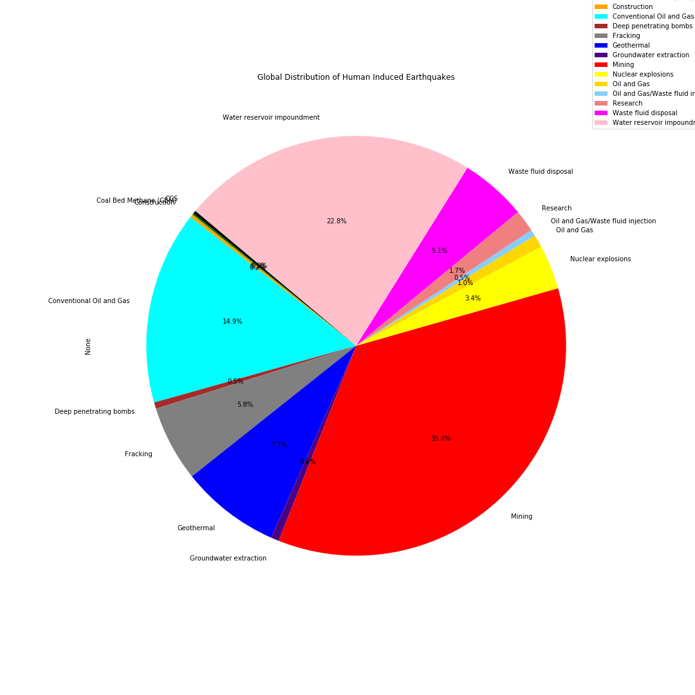
Which are the human activities that induce most earthquakes?
We found out that the top 5 human activities are:
Mining
Water Reservoir Impoundment
Conventional Oil and Gas
Geothermal
Fracking

Slide 8
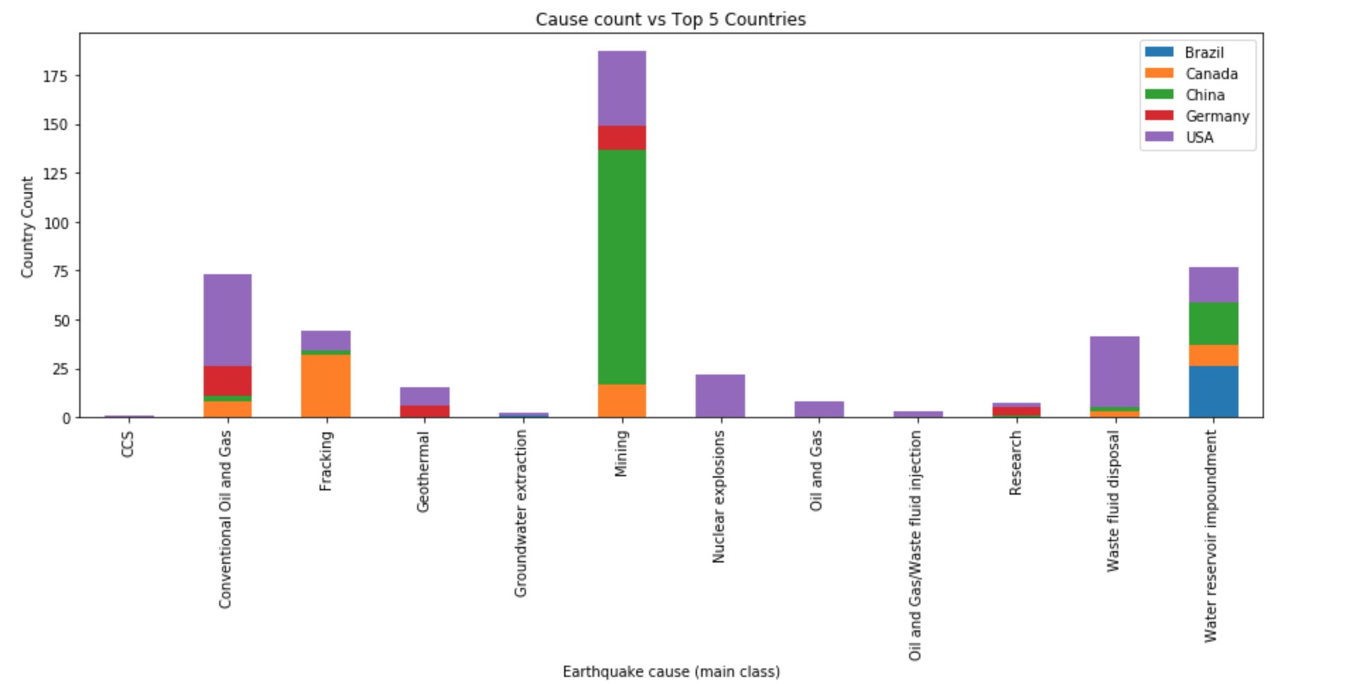
Which top 5 countries experience the most H.I. Earthquakes & which activity is the major contributor?
We can see that mining is the top cause of HI earthquakes. USA, Germany, Canada and China are the countries that experience most HI earthquakes from mining activity. In China, mining is the biggest cause of HI earthquakes.

Slide 9
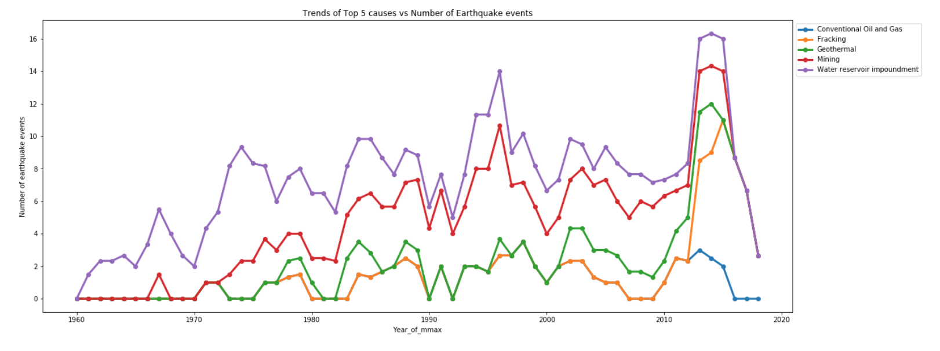
Trend of human induced earthquake causes over a period of time?
Over years Water reservoir impoundment has been the biggest cause of HI earthquakes while mining related earthquakes has been increasing in recent years. Since 2010 there has been a sharp uptick in HI earthquakes with Fracking becoming a significant portion of HI earthquakes.

Slide 10
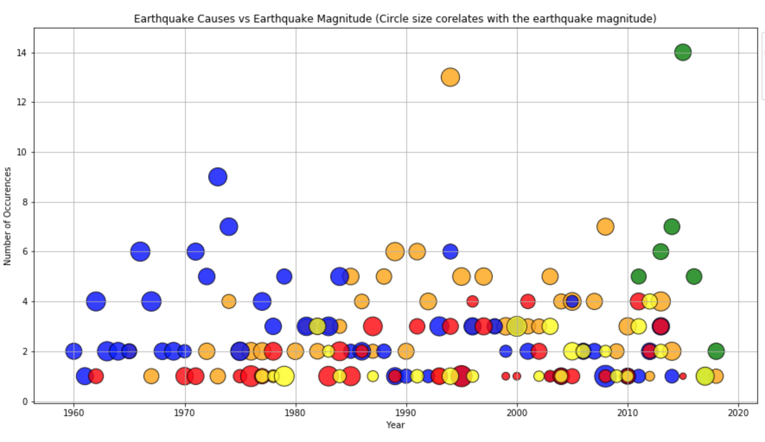
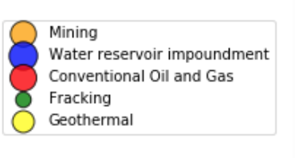
Determining how the cause influence the magnitude of earthquake?
Since earthquakes of large magnitude cause the most damage, we decided to dig further into the HI activity that induce the largest earthquakes. While in last century, water reservoir impoundment and mining induced the largest earthquakes, fracking is the leading cause of frequent and large earthquakes in this century.

Slide 11
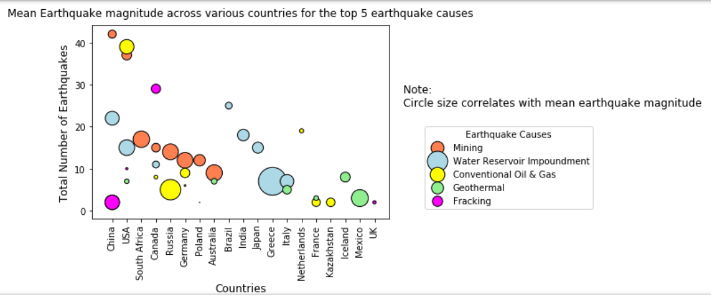
Observed Trends - Plots
As of today, the mean magnitude of earthquakes caused by top 5 causes ranges from 2.5 to 3.8
Water Reservoir Impoundment causes earthquakes of the highest magnitude with average magnitude of 3.8

Slide 12
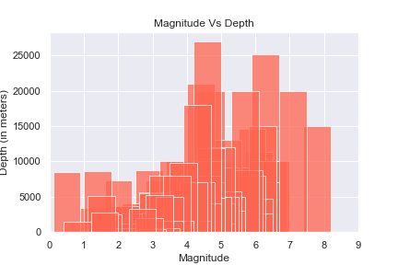
Is there a link between Depth and the Magnitude of the earthquake?
Magnitude Vs Depth
Based on my analysis, there are lot of low magnitude earthquakes that had occurred in low depths.
A study mention, Lower magnitude shallow earthquakes can cause more damages, than a higher magnitude deep earthquakes.
Matplotlib - Bar Chart

Slide 13
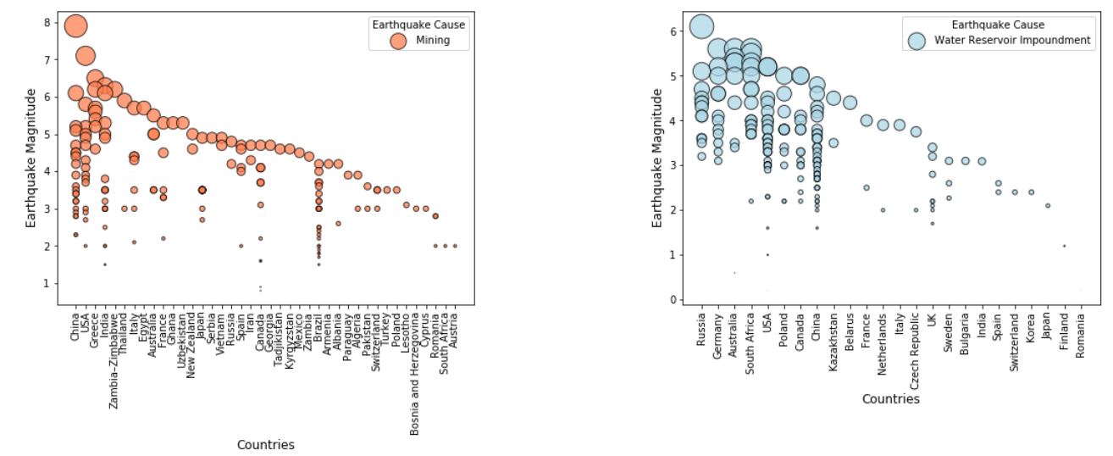
Is rapid industrialization the major cause of human induced earthquakes?

Slide 14
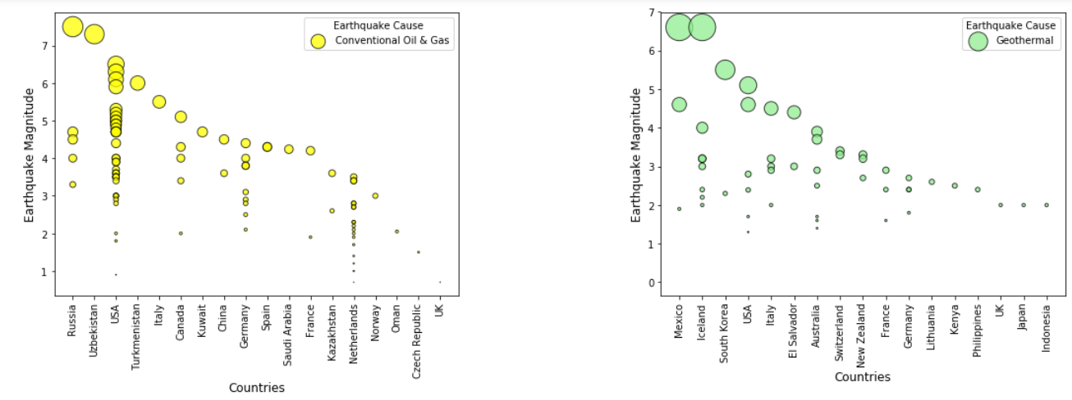
Scatter Plot for earthquake magnitude vs Countries

Slide 15
Observed Trends
The subplots clearly show that developed industrial countries like USA, China, Germany, Australia and Canada - are the ones most impacted by human induced activities such as Water Reservoir Impoundment, Mining and Conventional Oil & Gas.
The earthquake magnitude due to these activities ranges from 3 to 7.

Slide 16
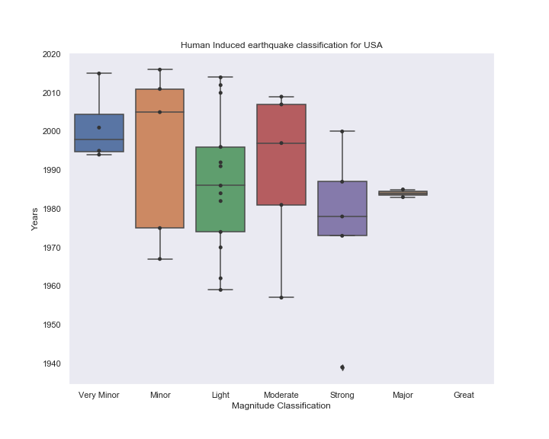
Based on the data, the number of HI earthquakes in USA has increased over the years.
Majority of observed HIQuakes fall under Minor to Moderate magnitude category.
Occurrences of HIQuakes in US
Seaborn library - Boxplot and Swarmplot

Slide 17
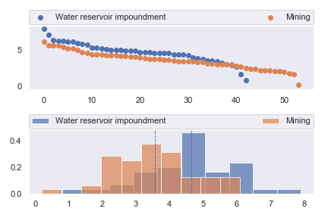
Statistics Analysis- Top 2 Causes and Magnitude
Hypothesis :
The magnitudes of HIQuakes caused by Mining is significantly different from magnitudes of HIQuakes caused by Water Reservoir Impoundment
Null Hypothesis:
The magnitudes of HIQuakes caused by Mining is NOT significantly different from magnitudes of HIQuakes caused by Water Reservoir Impoundment
Ttest_indResult
(statistic=4.154549887965083, pvalue=7.793388460472081e-05)
I am rejecting the Null Hypothesis

Slide 18
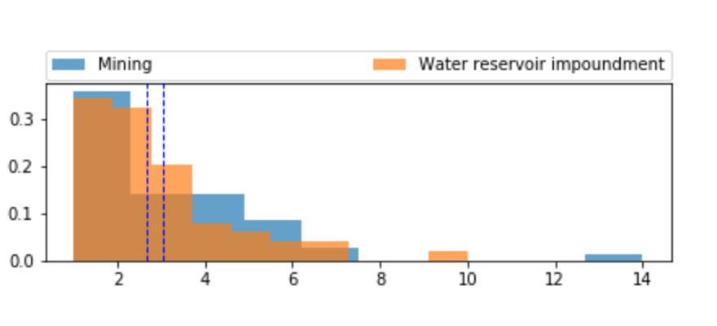
Statistical Analysis - Top 2 causes & Count of earthquakes
Hypothesis:
The hypothesis is that there is a significant difference between number of earthquakes caused by Mining and Water Reservoir Impoundment
Null Hypothesis:
There is no significant difference between the number of earthquakes caused by Mining and Water Reservoir Impoundment.
We cannot reject the null hypothesis.
statistic=1.020837375168213
pvalue=0.31459980625836836

Slide 19
Statistical Analysis
Conducted ANOVA test to understand if Mining across different countries causes earthquake with varying magnitudes.
Hypothesis: Mining in different countries lead to different magnitudes of earthquakes
Null Hypothesis: Mining in different countries does not lead to varying earthquake magnitudes.

Slide 20
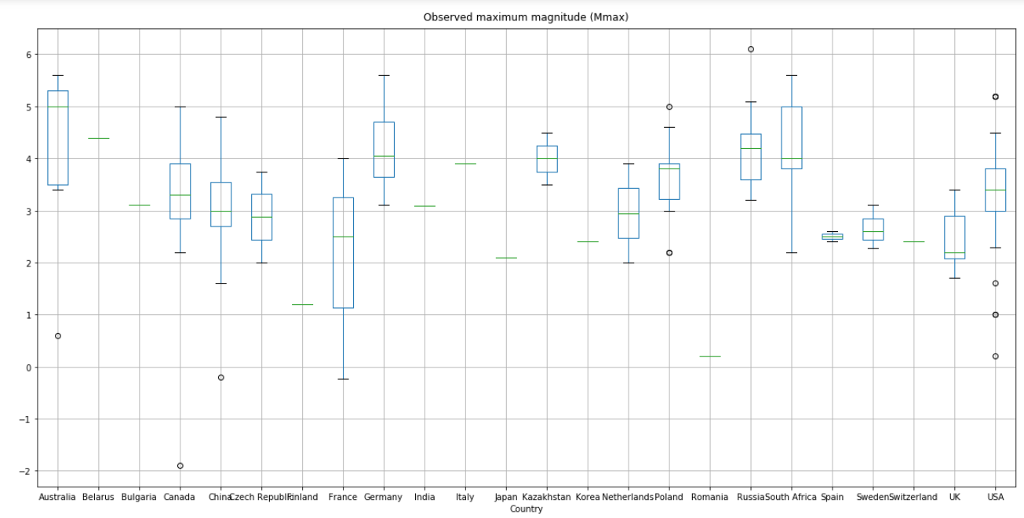
Boxplot grouped by country
F_onewayResult(statistic=5.420204985421187, pvalue=0.006088161629641385)
The p-value being <0.05, we can reject the null hypothesis and say that Mining across different countries does cause earthquakes with varying magnitudes as it depends on additional factors such as depth of project, underlying lithology etc.

Slide 21
Challenges we faced...
Finding the proper dataset
Git
Not able to find the API for global cities population
Moulding the data for the statistical analysis
Data visualization

Slide 22
Thank you !!

Slide 23
Questions ?

